Slide 1
Internet of things(iot) intership project in emertxe
BY:vinaygopal

Slide 2
KNOWLEDGE acquired
C PROGRAMMING
EMBEDDED SYSTEM
ARDUINO
PICSIM LAB
BLYNK APP

Slide 3
C PROGRAMMING
Where is it used?
● System Software Development
● Embedded Software Development
● OS Kernel Development
● Firmware, Middle-ware and Driver Development
● File System Development And many more!!

Slide 4
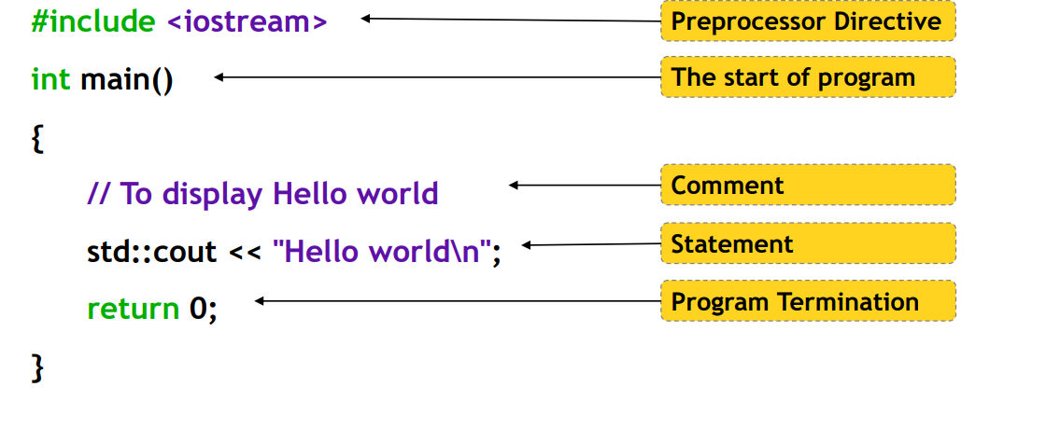
C PROGRAMMING

Slide 5
ARDUINO
ARDUINO PROGRSMMING
CONNECTING ARDUINO TO INTERNET
SIMULATION OF CODE USING PICSIM LAB

Slide 6
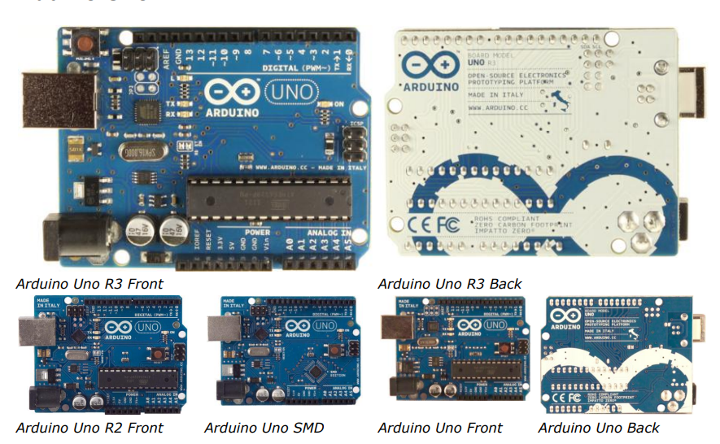
WHAT IS ARDUINO?
The Arduino Uno is a microcontroller board based on the ATmega328 (datasheet). It has 14 digital input/output pins (of which 6 can be used as PWM outputs), 6 analog inputs, a 16 MHz ceramic resonator, a USB connection, a power jack, an ICSP header, and a reset button. It contains everything needed to support the microcontroller; simply connect it to a computer with a USB cable or power it with a AC-to-DC adapter or battery to get started. The Uno differs from all preceding boards in that it does not use the FTDI USB-to-serial driver chip. Instead, it features the Atmega16U2 (Atmega8U2 up to version R2) programmed as a USB-to-serial converter.

Slide 7
INTERSHIP PROJECT
SMART HOME AUTOMATION
CONTROLING GARDEN LIGHTS
TEMPERATURE MONITERING AND CONTROLING BY COOLER AND HEATER
WATER TANK MONITERING BY CONTROLING INLET AND OUTLET VALVE

Slide 8
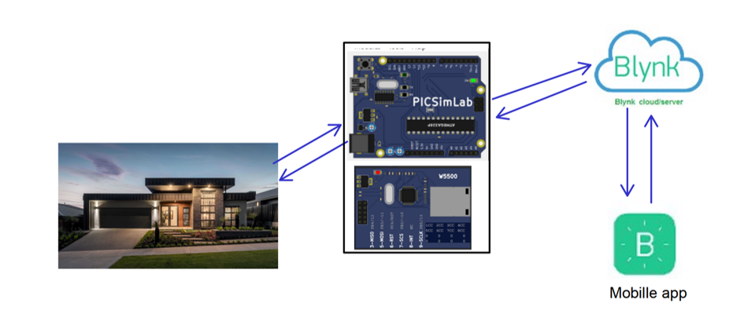
OVERVIEW OF WORKING OF PROJECT

Slide 9
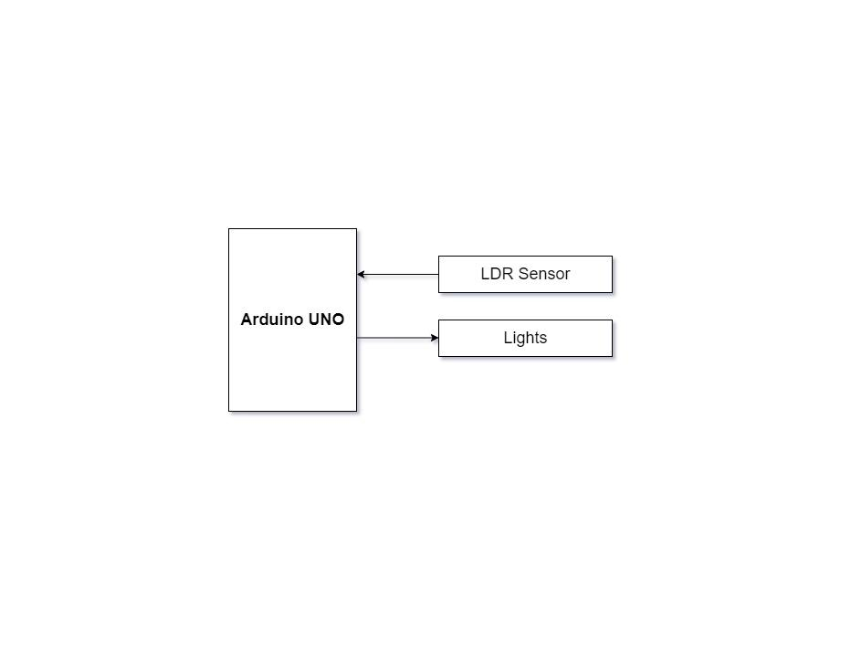
Garden lights control
Read the LDR sensor value, based on the reading from LDR, vary the brightness of the led, which resembles controlling garden lights based on the availability of sunlight
Requirement No | 1 – Garden lights control
Description | Inputs - LDR Sensor
 | Process - Read the LDR sensor value, based on the reading from LDR, vary the brightness of the led, which resembles controlling garden lights based on the availability of sunlight.
 | Output - Garden Lights

Slide 10
Temperature Control System
The temperature control system consists of a heating resistor, an LM35 temperature sensor, and a cooler. Which resembles the temperature control system at home. Read the temperature from the temperature sensor LM35 and display it on the CLCD. Control the temperature of the system by turning ON/OFF the heater and cooler through the Blynk IOT mobile app .

Slide 11
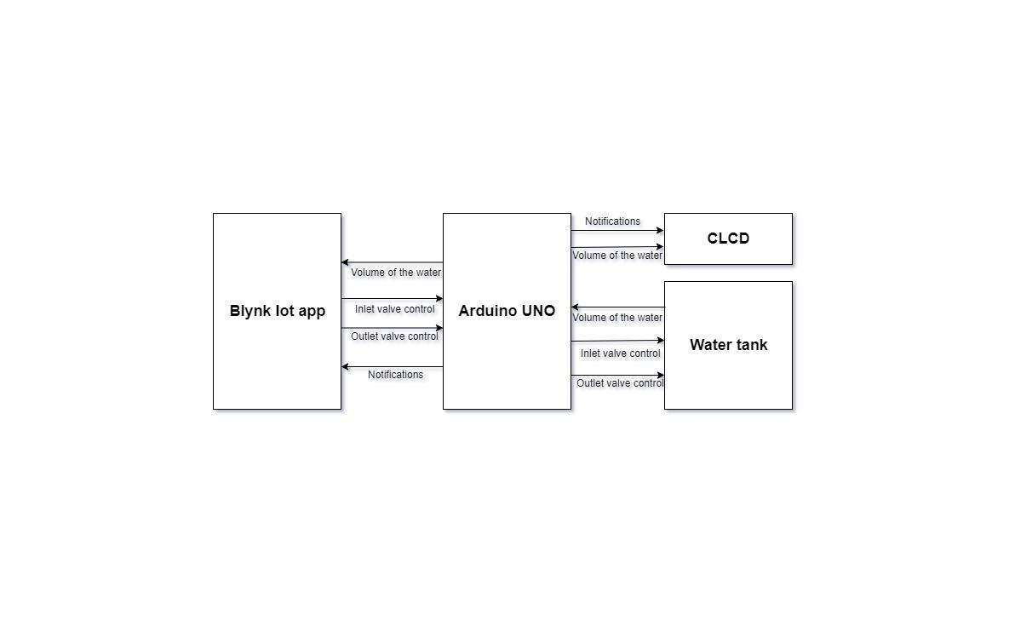
Temperature Control System

Slide 12
Temperature Control System
Requirement No | 2 – Temperature Control System
Description | Inputs - Temperature Sensor.
 | Process - Read Temperature from temperature sensor LM35.
 | Output - Display Temperature on Gauge Widget, Display Temperature on CLCD.

Slide 13
Temperature Control System
COOLER CONTROL SYSTEM REQUIRMENTS
Requirement No | 3 – Cooler Control System
Description | Inputs - Button Widget(Cooler button) on Blynk iot app .
 | Process - Detect the change in the logic level
 | Output - if the Button widget is at logic high, turn ON the cooler. if the Button widget is at logic low, turn OFF the cooler.

Slide 14
Temperature Control System
HEATER CONTROL SYSTEM REQUIRMENTS
Requirement No | 4 – Heater Control System
Description | Inputs - Button Widget(Heater button) on Blynk iot app .
 | Process - Detect the change in the logic level
 | Output - if the Button widget is at logic high, turn ON the heater. if the Button widget is at logic low, turn OFF the heater.

Slide 15
Temperature Control System
IF TEMPERATURE MORE THAN 35 DEGREE THEN
When the heater is ON if the temperature rises above 35 degree celsius then heater should turn OFF automatically and message “Temperature is more than 35 degree celsius Turning OFF the heater” should be displayed on the virtual terminal, “HT_R OFF” on CLCD.
When the water in the tank is full, turn off the inlet valve automatically and display “water level is full water inflow disabled” .
Requirement No | 5 – Threshold temperature control
Description | Inputs - Temperature sensor
 | Process - Read and compare the temperature with 35 degrees
 | Output - if the temperature is more than 35 turn OFF the heater and send notification to Blynk IOt app and display the same on the CLCD. .

Slide 16
water tank inlet and outlet valve control
Read the volume of the water in the tank through Serial Communication and display it on the CLCD, control the volume of the water in the tank by controlling the inlet and outlet valve, by sending commands through serial communication. Display the volume of water in the tank on the CLCD

Slide 17
water tank inlet and outlet valve control
REQUIRMENTS
Requirement No | 6 – Display the volume of water in the tank
Description | Inputs - Serial tank.
 | Process - Read the volume of the water in the tank by sending commands through serial communication.
 | Output - Display the volume of the water on Gauge Widget Display the volume of water on CLCD.
Requirement No | 7 – Inlet valve control
Description | Inputs - Button Widget(Inlet valve button) on Blynk iot app .
 | Process - Detect the change in the logic level
 | Output - if the Button widget is at logic high, turn ON the inlet valve by sending commands through serial communication. if the Button widget is at logic low, turn OFF the inlet valve by sending commands through serial communication.

Slide 18
water tank inlet and outlet valve control
INLET VALVE CONTROL REQUIRMENTS
Requirement No | 6 – Display the volume of water in the tank
Description | Inputs - Serial tank.
 | Process - Read the volume of the water in the tank by sending commands through serial communication.
 | Output - Display the volume of the water on Gauge Widget Display the volume of water on CLCD.

Slide 19
water tank inlet and outlet valve control
OUTLET VALVE CONTROL REQUIRMENTS
Requirement No | 8 – Outlet valve control
Description | Inputs - Button Widget(outlet valve button) on Blynk iot app .
 | Process - Detect the change in the logic level
 | Output - if the Button widget is at logic high, turn ON the outlet valve by sending commands through serial communication. if the Button widget is at logic low, turn OFF the outlet valve by sending commands through serial communication..

Slide 20
Control the volume of water in the tank
REQUIRMENTS
Requirement No | 9 – Control the volume of water in the tank
Description | Inputs - Serial tank.
 | Process - Read the volume of the water in the tank by sending commands through serial communication.
 | Output - if the volume of water in the tank is less than 2000 ltrs turn ON the inlet valve, and send notification to the blynk mobile app and display the same on the CLCD.

Slide 21
BLYNK APPLICATION
Blynk was designed for the Internet of Things. It can control hardware remotely, it can display sensor data, it can store data, visualize it and do many other cool things.
Create widgets on Mobile blynk application
Button widgets to control heater, cooler, inlet valve , outlet value.
Gauge widgets to display temperature and volume of the water in the tank on the mobile application
Terminal widgets to display the notifications whenever threshold is crossed like
“Temperature is more than 35 degrees”, “” turning OFF the heater”, “water level is full “
“Water inflow disabled”

Slide 22
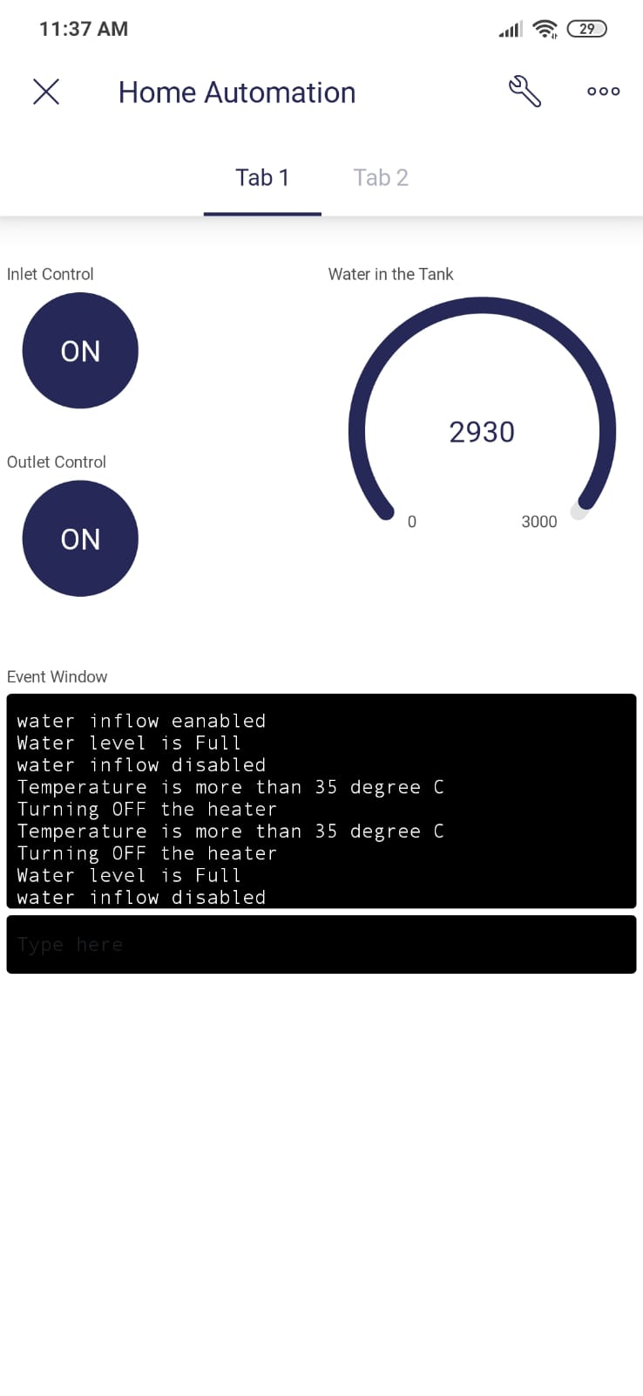
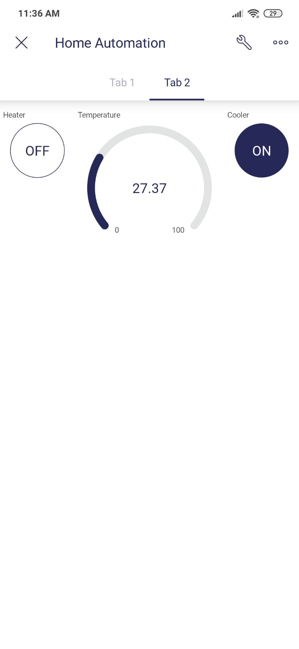
BLYNK APPLICATION
SCREENSHOTS OF BLYNK INTERFACE

Slide 23
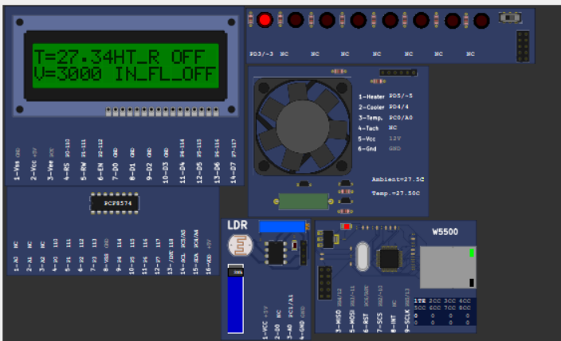
PICSIM LAB SIMULATOR
SCREENSHOT OF FINAL COMPONENTS

Slide 24
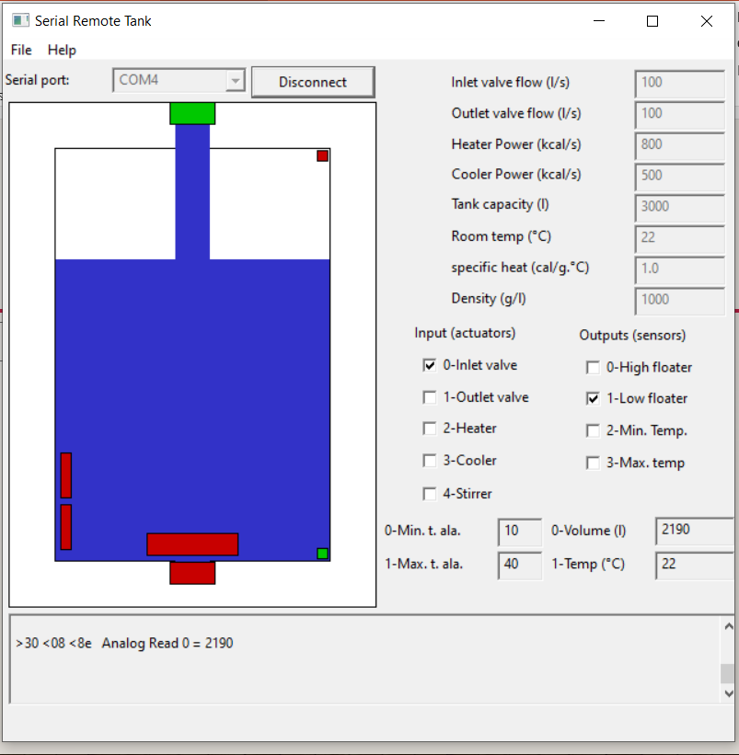
PICSIM LAB SIMULATOR
SCREENSHOT OF FINAL COMPONENTS

Slide 25
THANK YOU

